Slide 1
Biweekly Meeting for RL Based Truck&Trailer Project
April 14 2023

Slide 2
Recently Updates
Find articles to fill in the literature review part of the paper
Revise the reward function and conduct experiments on two reward structure
Fine tune the hyperparameter of the reward structure.

Slide 3
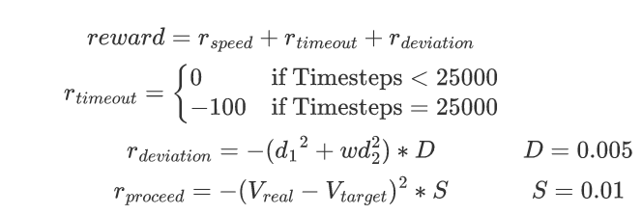
Different Structure of the reward
Reward 1

Slide 4
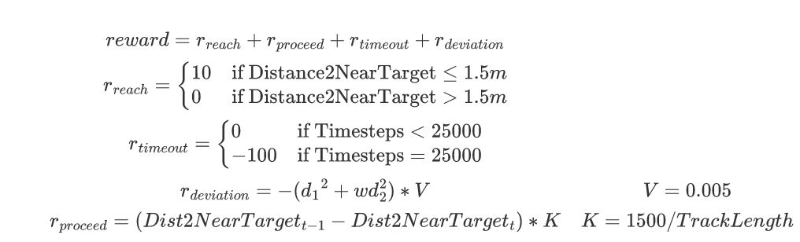
Different Structure of the reward
Reward 2

Slide 5
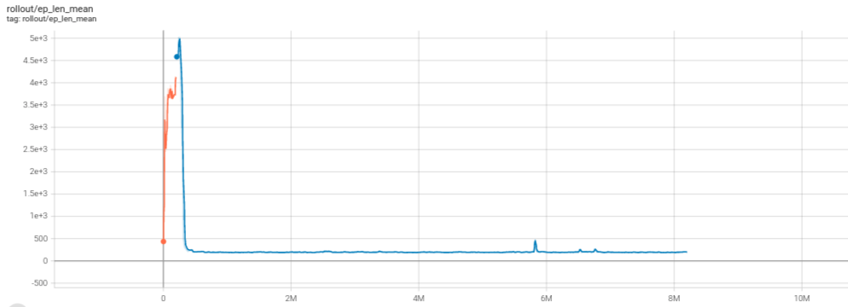
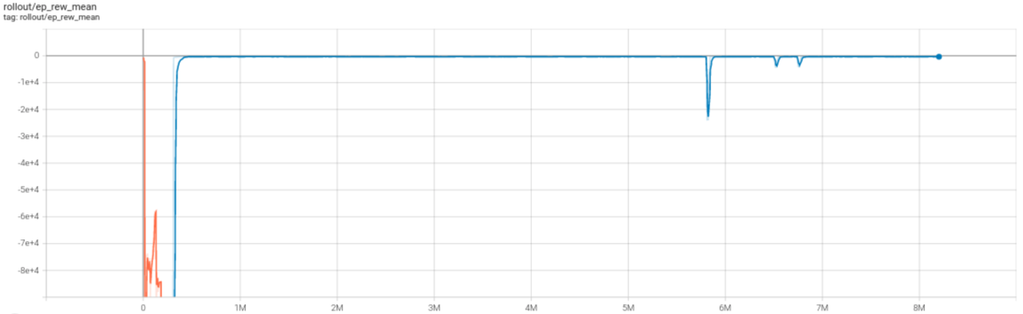
Learning curve of Reward V1

Slide 6
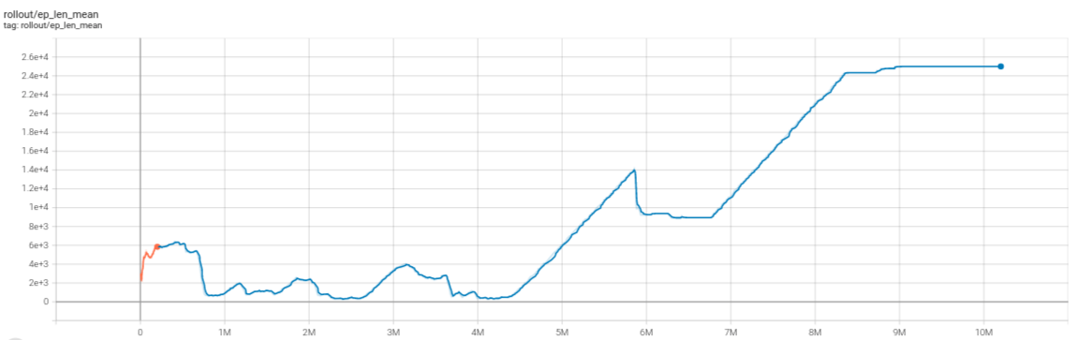
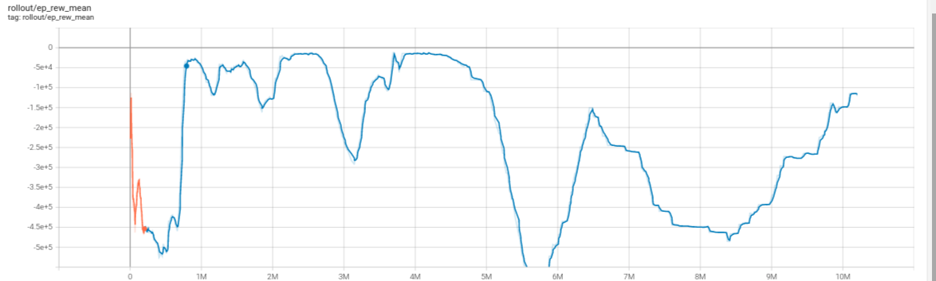
Learning curve of Reward V2

Slide 7
Plans for next two weeks
Continue fine tune the hyperparameter of the reward structure
Check the waypoint update policy
Craft the evaluation scenarios for trained model
Try to finish the literature review and simulation part of the paper
More look ahead waypoints, deviation reward, target speed

